Slide 1
Case Study
MapReduce Computing Framework and Hadoop System

Slide 2
The Context: Big-data
We are in a knowledge economy.
Data is an important asset to any organization
Discovery of knowledge; Enabling discovery; annotation of data
We are looking at newer
programming models, and
Supporting algorithms and data structures.
National Science Foundation (NSF) refers to it as “data-intensive computing” and industry calls it “big-data” and “cloud computing”.

Slide 3
Motivation
Process lots of data
Google processed about 24 petabytes of data per day in 2009.
A single machine cannot serve all the data
You need a distributed system to store and process in parallel
Parallel programming?
Threading is hard!
How do you facilitate communication between nodes?
How do you scale to more machines?
How do you handle machine failures?

Slide 4
MapReduce
MapReduce [OSDI’04] provides
Automatic parallelization, distribution
I/O scheduling
Load balancing
Network and data transfer optimization
Fault tolerance
Handling of machine failures
Need more power: Scale out, not up!
Large number of commodity servers as opposed to some high-end specialized servers
Apache Hadoop:
Open source implementation of MapReduce

Slide 5
MapReduce
MapReduce has three main phases
Map (send each input record to a node)
Shuffle/Sort (transfer intermediate results from Map phase to proper places)
handled behind the scenes
Reduce (operate on intermediate results to get the final results)

Slide 6
Typical problem solved by MapReduce
Read a lot of data
Map: extract something you care about from each record
Shuffle and Sort
Reduce: aggregate, summarize, filter, or transform
Write the results

Slide 7
MapReduce workflow
Input Data
Output Data
Worker
write
Output
File 0
local
write
Worker
Split 0
read
Split 1
Worker
Split 2
Output
File 1
Worker
Worker
remote
read,
sort
Map
extract something you care about from each record
Reduce aggregate, summarize, filter, or transform

Slide 8
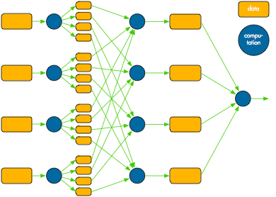
Mapreduce overview
Map
Shuffle/Sort
Reduce

Slide 9
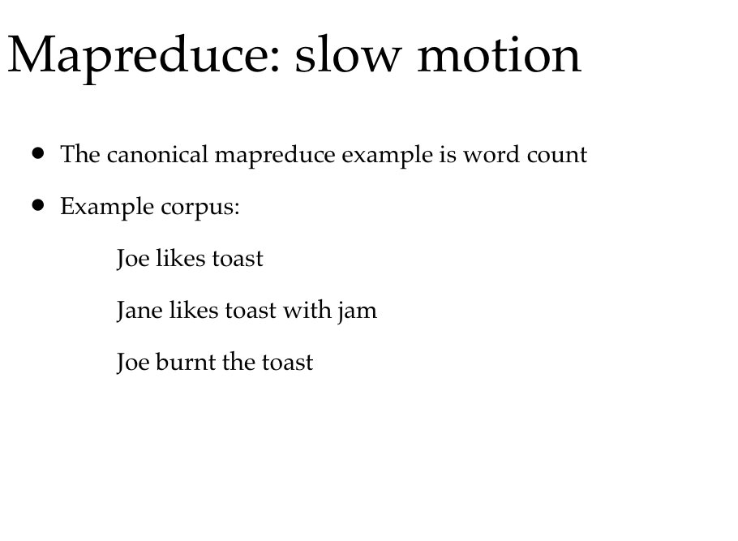

Slide 10
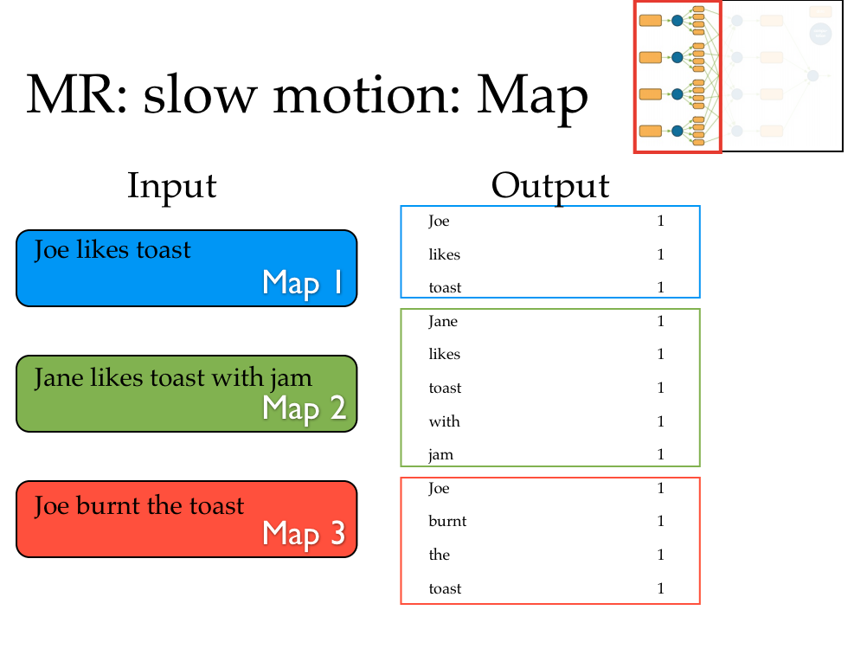
In this example, we assume we have 3 workers for Map phase (3 Mappers).

Slide 11
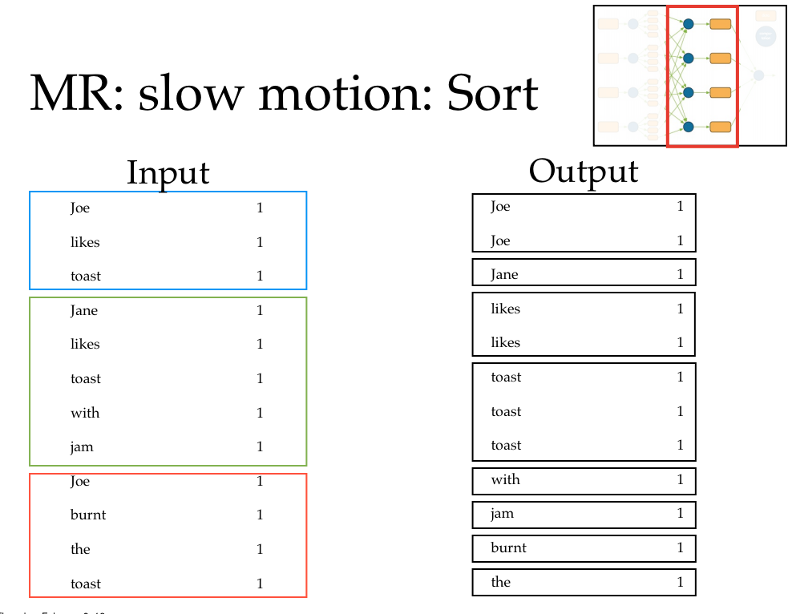
Reducer 1
Reducer 2
Reducer 3
Reducer 4
Reducer 5
Reducer 6
Reducer 7
Reducer 8
In this example, we assume we have 8 workers for Reduce phase (8 Reducers).

Slide 12
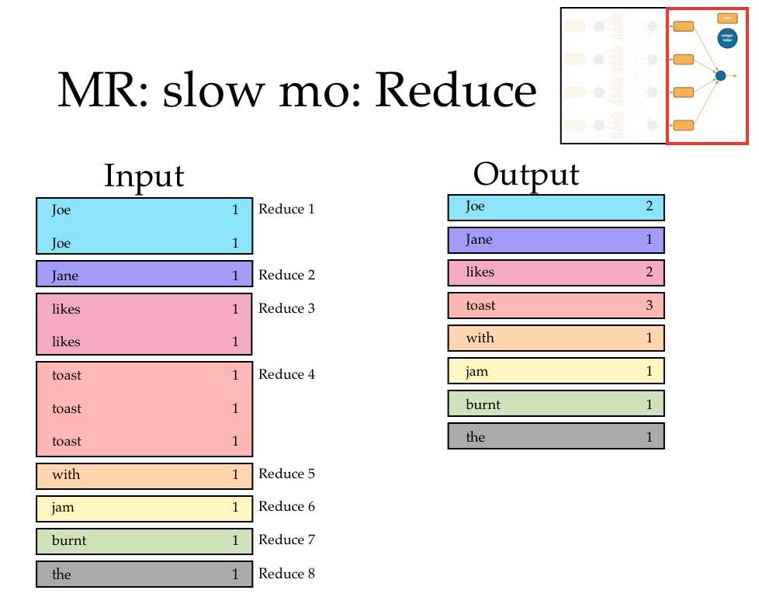

Slide 13
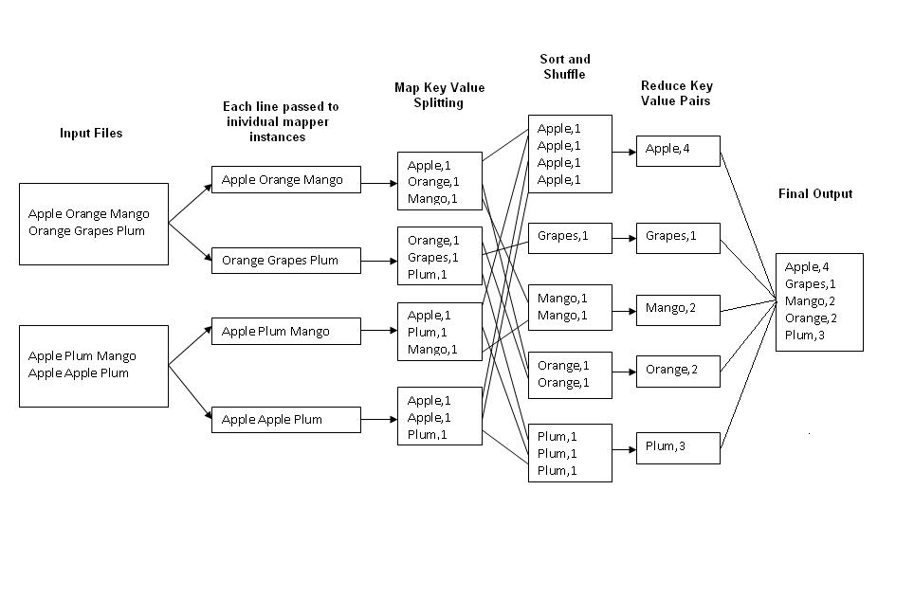
Word Count: Another Example
http://kickstarthadoop.blogspot.ca/2011/04/word-count-hadoop-map-reduce-example.html

Slide 14
TeraSort
TeraSort is a benchmark for evaluating sorting speed.
Created by Jim Gray in 1998.
Sort 10 billion 100-Byte records
In 2008, a Hadoop MapReduce cluster won the first place: 209 seconds
910 nodes
4 dual core Xeons @ 2.0ghz per a node
4 SATA disks per a node
8G RAM per a node
1 gigabit ethernet on each node
40 nodes per a rack
8 gigabit ethernet uplinks from each rack to the core
Red Hat Enterprise Linux Server Release 5.1 (kernel 2.6.18)
Sun Java JDK 1.6.0_05-b13

Slide 15
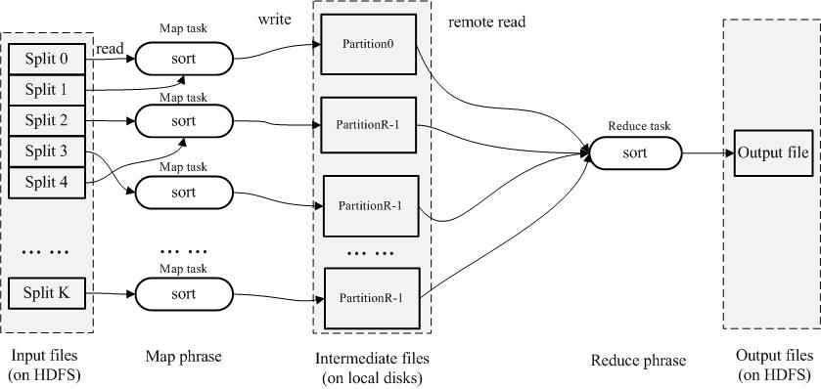
Initial idea: only one reducer
Only taking advantage of parallelism in the Map phase, rather than in the Reduce phase.

Slide 16
TeraSort
A custom partitioner that uses a sorted list of N − 1 sampled keys that define the key range for each reduce.
In particular, all keys such that sample[i − 1] <= key < sample[i] are sent to reduce i.
This guarantees that the output of reduce i are all less than the output of reduce i+1.
TeraSort generates the sample keys by sampling the input before the job is submitted and writing the list of keys into HDFS.

Slide 17
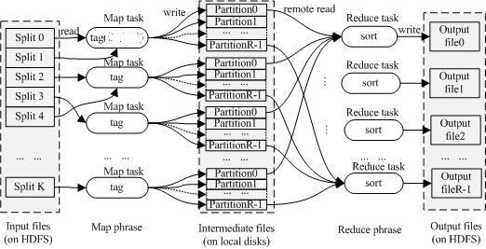
Multiple reducers
Partition 0 < Partition 1 < Partition 2 < … < Partition R-1 for all intermediate results

Slide 18
Mappers and Reducers
Need to handle more data? Just add more Mappers/Reducers!
No need to handle multithreaded code ☺
Mappers and Reducers are typically single threaded
Mappers/Reducers run entirely independent of each other
In Hadoop, they run in separate JVMs

Slide 19
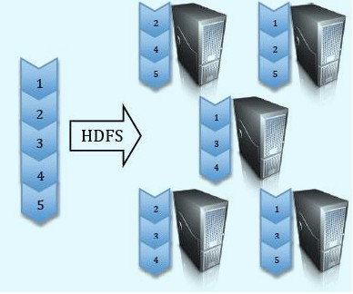
Hadoop Distributed File System (HDFS)
Split data and store 3 replica on commodity servers

Slide 20
Components
Master (NameNode)
Manages metadata
Not involved in data transfer
Controls allocation, placement, replication
Chunk Server (DataNode)
Stores chunks of data
Built on local Linux file system

Slide 21
HDFS Architecture
NameNode
1. filename
2. BlckId, DataNodes
o
Secondary
NameNode
Client
3.Read data
DataNodes
Name Node: Maps a file to a file-id and list of MapNodes
Data Node: Maps a block-id to a physical location on disk
Notes:
21

Slide 22
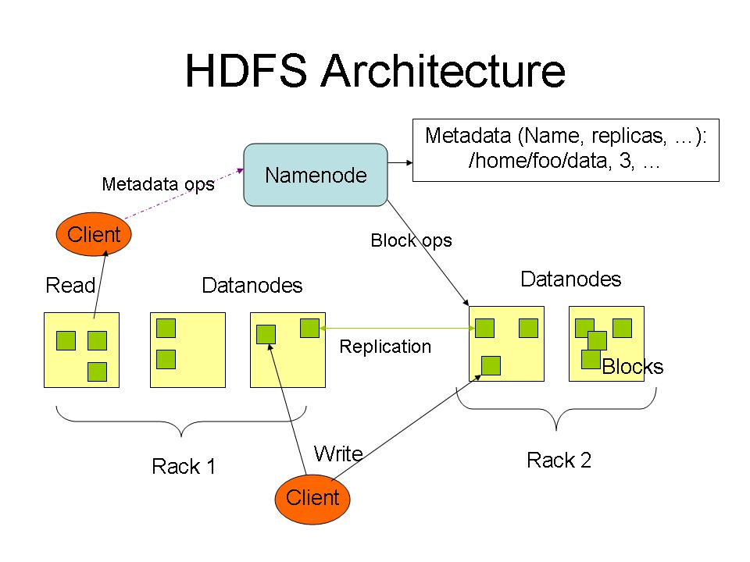

Slide 23
Locality Optimization
Master scheduling policy:
Asks HDFS for locations of replicas of input file blocks
Map tasks scheduled so HDFS input block replica are on same machine or same rack as the mappers
Effect: Thousands of machines read input at local disk speed
Eliminate network bottleneck!

Slide 24
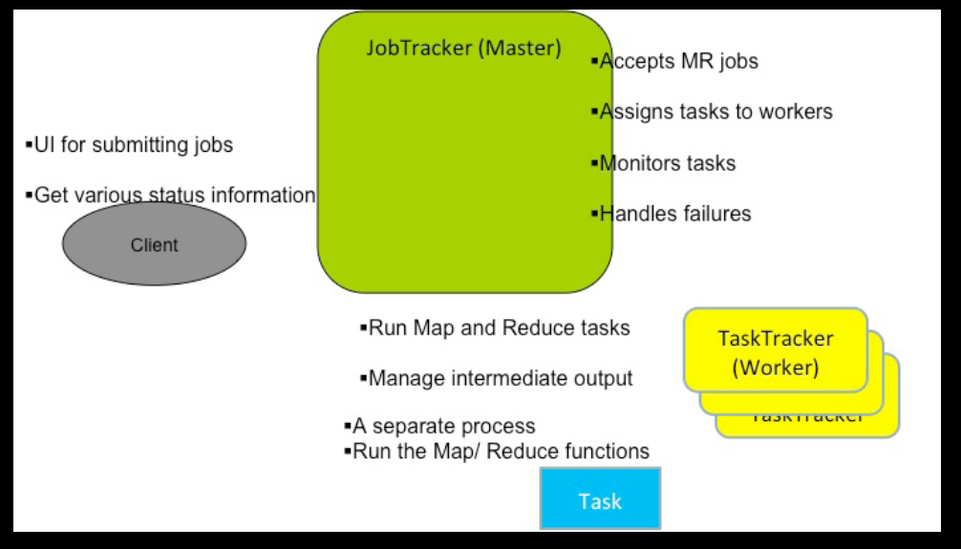
Components in a Hadoop MR Workflow

Slide 25
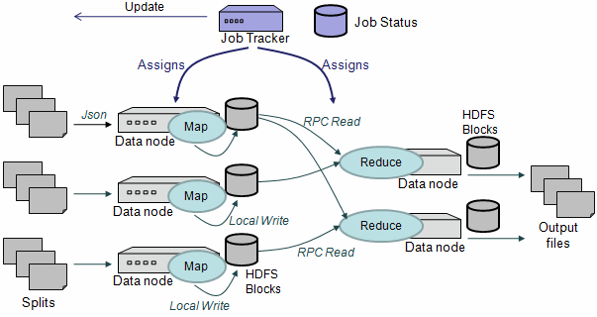

Slide 26
Failure of the system
How big of a deal is it really?
A huge deal. In a distributed environment disks fail ALL THE TIME.
Large scale systems must assume that any process can fail at any time.
It may be much cheaper to make the software run reliably on unreliable hardware than to make the hardware reliable.

Slide 27
Failure in MapReduce
Failures are norm in commodity hardware
Worker failure
Detect failure via periodic heartbeats
Re-execute in-progress map/reduce tasks
Master failure
Single point of failure; Resume from Execution Log
Robust
Google’s experience: lost 1600 of 1800 machines once!, but finished fine

